Slide 1
“Job Search Application”
Task - 1

Slide 2

Your Project Name
A job search application is a software platform that helps job seekers find job opportunities based on their skills, preferences, and location. These applications aggregate job postings from various sources such as company career pages, job boards, and social media sites. They allow users to search for jobs using keywords, location, and other criteria, and often provide additional features like resume builders, job alerts, and career advice. Job search applications can be accessed through a desktop computer or mobile device, and are often available for free or for a subscription fee.

Slide 3
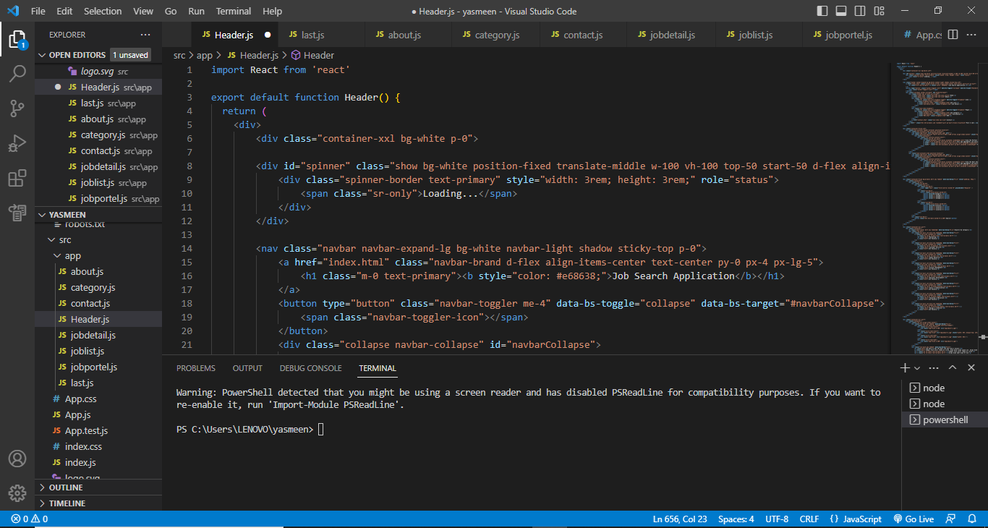

Slide 4


Slide 5
Assessment Parameter
Gather requirements for the project
add Readme.md file with description of the project
Prepare database design schemas
Check-List
Commit all changes with "first commit"
Get your initial project Structure ready
create a repository on github realted to project
Initiate a git repository
Push your changes to github

Slide 6
Submission Github
https://github.com/yasuma26112002/yasmeen-.git

